Slide 1


P.S.V COLLEGE OF ENGINEERING AND TECHNOLOGY
(An Autonomous Institution)
(Approved by AICTE, New Delhi & Affiliated to Anna University, Chennai)
Accredited by NAAC with ‘A’ Grade | Accredited by the NBA(CSE)
Mittapalli, Balinayanapalli Post , Krishnagiri-635108
(Inclusion Under Section 2(f) & 12(B) of the UGC Act,1956)
(AN ISO 9001:2015 Certified Institution)
DEPARTMENT OF COMPUTER SCIENCE AND ENGINEERING
TO IMPLEMENT AN AI AVATAR ASSISTANCE FOR ONLINE HOTEL ROOM BOOKING
Guided By :
Prof .K. Nandini M.E.,
Project Co-Ordinator:
Prof. C.Prakash Naranyanan M.E,(Ph.d).,
Presented By :
Kiran Kumar. C (611821104020)
Kishore. M (611821104021)
Rohith. S (611821104043)

Slide 2
Abstract
The AI Avatar Assistance system provides real-time, interactive guidance to users during the hotel room booking process, improving usability and engagement
The rapid growth of digital platforms has transformed the hospitality industry, especially in online hotel room booking, though customers still face challenges like lack of personalization and real-time assistance.
To overcome these issues, AI Avatar Assistance systems provide intelligent, interactive support to enhance booking efficiency and user experience.
The AI avatar uses Natural Language Processing (NLP) and Machine Learning (ML) to offer personalized recommendations, answer queries, and guide users through room selection and payment processes.
This AI-driven approach improves customer satisfaction by reducing booking time, minimizing confusion, and enabling a more efficient and user-friendly digital booking system.
By reducing booking time and minimizing user confusion, the AI-driven approach enhances customer satisfaction, efficiency, and overall booking reliability

Slide 3
Introduction
The Traditional booking platforms often lack personalized assistance and real-time interaction, leading to user confusion and reduced satisfaction.
AI Avatar Assistance is an intelligent virtual system that simulates human-like interaction to guide users throughout the hotel booking process. It uses technologies such as Natural Language Processing and Machine Learning to understand user queries and provide accurate responses.
The system offers personalized recommendations based on user preferences like budget, location, amenities, and room availability. It provides 24/7 support, multilingual communication, and interactive guidance to improve customer engagement.
This project aims to develop an AI-powered virtual assistant that simplifies the booking process, reduces decision-making time, and enhances overall customer experience, making online hotel booking smarter and more efficient

Slide 4
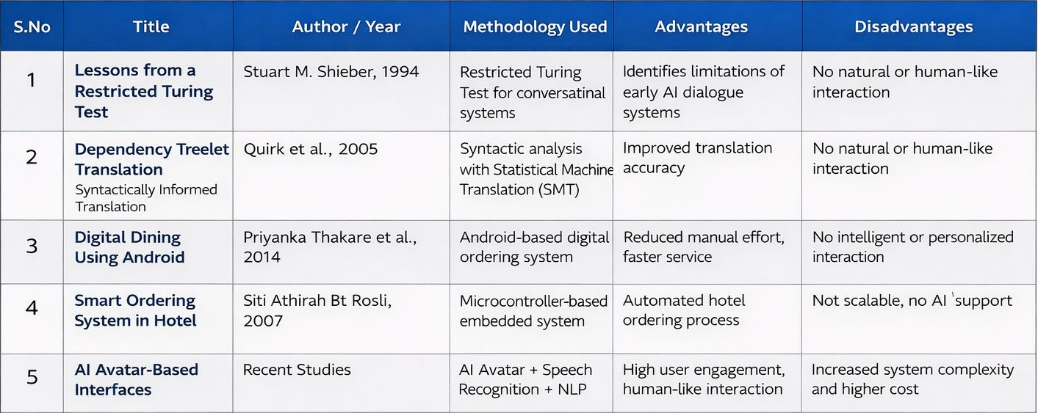
Literature Survey

Slide 5
Existing System
The booking platform operates as a static system that only displays hotel listings and does not provide intelligent or interactive guidance to assist users
Users are required to manually search for hotels by applying basic filters such as location, price range, and amenities, which demands more effort and time.
Hotel recommendations are mostly generic and are based on popular choices or simple search history rather than detailed user preferences or behavior analysis.
Users must compare multiple hotel options individually by navigating between different pages, which increases complexity and decision-making time.
Customer support is limited to FAQs or delayed responses through email or chat, with no real-time virtual assistant available during the booking process.
The system provides limited multilingual support, making it difficult for international users to clearly understand booking policies, pricing, and terms.

Slide 6
Disadvantages
Due to the lack of advanced personalization, users often receive generic hotel recommendations that may not match their specific preferences.
The absence of real-time interactive assistance can cause confusion during room selection, pricing review, and payment steps.
Customer support response times are slow since assistance is mainly limited to FAQs or delayed communication channels.
The booking process becomes Requires excessive users time must manually search, filter, and compare multiple hotel options before making a decision.
Limited multilingual support creates difficulties for international users in understanding hotel policies, pricing details, and booking terms.
The availability of too many options without intelligent guidance leads to decision fatigue, increasing the chances of booking abandonment.

Slide 7
Proposed System
The proposed system introduces an AI-powered virtual avatar that interacts with users in real time, providing intelligent guidance throughout the hotel room booking process.
It integrates Natural Language Processing (NLP) to understand user queries and respond in a conversational manner, making the booking experience more intuitive and user-friendly.
Machine Learning techniques are used to analyze user preferences and booking history to generate personalized hotel and room recommendations.
The system processes real-time data to display updated room availability, pricing, and offers, reducing booking errors and improving reliability.
Multilingual support and continuous availability ensure seamless access for users from different regions and time zones, enhancing overall customer satisfaction

Slide 8
Advantages
The AI avatar delivers a highly interactive and user-friendly experience by simulating human-like conversation, guiding users smoothly through hotel search, room selection, and booking completion.
By using machine learning algorithms, the system analyzes user preferences such as budget, location, amenities, and previous booking behavior to provide accurate and personalized hotel recommendations.
Real-time assistance allows users to ask questions and receive instant responses, reducing confusion related to pricing, availability, policies, and payment procedures.
The automated guidance significantly reduces booking time by eliminating the need for repeated manual searches and comparisons across multiple hotel listings.
The system operates 24/7 without human intervention, ensuring uninterrupted support and convenience for users regardless of time or location.
Multilingual support enables users from different regions to interact comfortably in their preferred language, improving accessibility, trust, and overall customer satisfaction.,

Slide 9
System Requirements
Hardware Requirements:
1. Client-Side Requirements
Desktop/Laptop with minimum Intel i3 processor or higher.
Minimum 4GB RAM for smooth system performance.
Smartphone (Android/iOS) for mobile access.
Stable internet connection for real-time booking and interaction.
2. Server-Side Requirements
Intel i5/i7 processor or higher for handling AI processing.
Minimum 8GB RAM (16GB recommended for better performance).
Minimum 256GB SSD storage for faster data access.
Cloud or dedicated server infrastructure for database and API management.

Slide 10
System Requirements
Software Requirements:
1.Operating System
Windows is required to develop and deploy the application.
2.Front-End Technologies
React.js, HTML, CSS, and JavaScript are used to design the interactive user interface.
3.Back-End Technologies
Python and Flask are used to handle server-side logic and API communication.
4.AI & Integration Tools
OpenAI API and LiveKit are used to enable AI avatar interaction and NLP processing.
5.Database & Environment Tools
Environment configuration and data handling are managed using supporting libraries and storage systems.

Slide 11
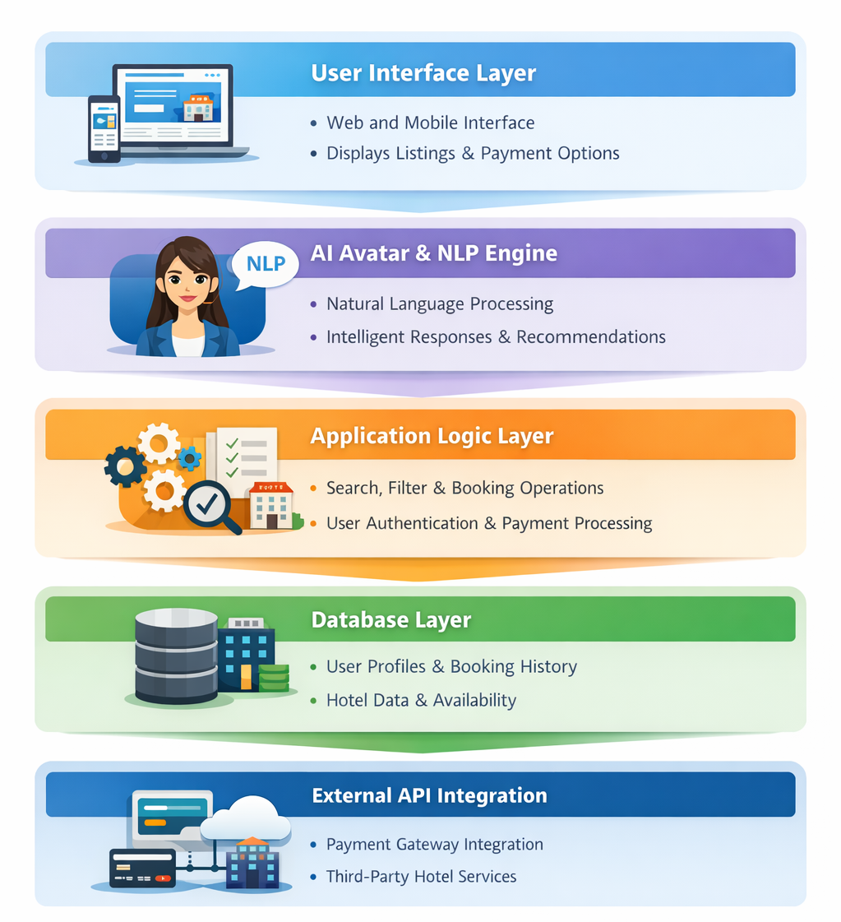
System Architecture

Slide 12
Modules
User Interface Layer
AI Avatar & NLP Engine
Application Logic Layer
Database Layer
External API Integration

Slide 13
Module Description
User Interface Layer
This layer provides a responsive and interactive web and mobile interface that allows users to easily access all hotel booking functionalities without technical complexity.
Users can search for hotels using multiple filters such as price range, location, room type, ratings, and available amenities, helping them narrow down suitable options efficiently.
The interface displays real-time room availability, dynamic pricing, special offers, and multiple payment options in a clear and user-friendly manner.
It supports secure user registration and login, enabling users to manage their profiles, store preferences, and view past booking history.
This layer serves as the primary communication bridge between the user and the AI avatar, ensuring smooth interaction and seamless navigation throughout the booking process.

Slide 14
Module Description
AI Avatar & NLP Engine
This module enables human-like interaction by allowing users to communicate with the system through conversational text or voice-based input.
Natural Language Processing (NLP) techniques are used to understand user queries, identify intent, and extract relevant information accurately.
The AI avatar intelligently responds to user questions related to hotel availability, booking steps, pricing details, cancellation policies, and payment procedures.
By analyzing user preferences, past interactions, and behavior patterns, the AI avatar provides personalized hotel and room recommendations.
Continuous assistance is provided throughout the booking journey, reducing user confusion, improving clarity, and enhancing overall decision-making.

Slide 15
Module Description
Application Logic Layer
This layer manages the core functionality of the system, including hotel search operations, filtering mechanisms, room selection, and booking confirmation workflows.
It handles user authentication, session management, and access control to ensure that only authorized users can perform booking-related actions.
The layer processes booking requests by validating user inputs, checking room availability, and coordinating with payment gateways for transaction handling.
It ensures seamless communication between the user interface, AI avatar module, database layer, and external APIs.
Business rules and system workflows are enforced at this layer to maintain consistency, reliability, and correct execution of all user actions.

Slide 16
Module Description
Database Layer
This layer securely stores user-related information such as profile details, login credentials, and personalized preferences.
It maintains complete booking records, including reservation details, transaction history, and payment status for future reference.
Hotel-related data such as room categories, availability, pricing, amenities, and hotel policies are stored and managed efficiently.
Room availability is updated in real time after successful bookings, cancellations, or modifications to avoid conflicts and overbooking.
Optimized data retrieval mechanisms ensure fast response times and a smooth user experience during peak usage.

Slide 17
Module Description
External API Integration
This module integrates secure payment gateways to enable safe and reliable online transactions during the booking process.
It connects with third-party hotel service providers and booking platforms to fetch real-time hotel availability, pricing, and offers.
External APIs are used to send booking confirmations, payment receipts, and alerts through SMS, email, or WhatsApp notifications.
The integration layer supports system scalability by allowing additional services and APIs to be incorporated without major architectural changes.
Reliable communication with external platforms enhances system functionality, accuracy, and overall service quality.

Slide 18
Conclusion
The proposed AI Avatar Assistance system significantly enhances the online hotel room booking process by providing intelligent, interactive, and personalized user support. By integrating an AI avatar with Natural Language Processing and machine learning techniques, the system enables real-time communication, accurate query handling, and customized hotel recommendations based on user preferences. The architecture ensures seamless interaction between the user interface, application logic, database, and external services, resulting in faster booking and reduced user confusion. Features such as real-time availability updates, secure payment integration, and multilingual support further improve accessibility and reliability. Overall, the system offers a smarter, more efficient, and user-centric approach to online hotel booking, leading to improved customer satisfaction and operational efficiency.

Slide 19
Future Enhancement
The AI Avatar Assistance system for online hotel room booking can be further enhanced by incorporating advanced voice-based interaction features, enabling users to complete the entire booking process through natural speech communication. Future versions can integrate more sophisticated deep learning–based recommendation engines to provide highly personalized hotel suggestions based on user behavior, preferences, and booking history.
The system can also be expanded by developing dedicated Android and iOS mobile applications to improve accessibility and user experience. Integration with multiple global hotel APIs would allow real-time availability updates and competitive price comparisons across different platforms. Additionally, implementing advanced security mechanisms such as two-factor authentication and encrypted payment processing will enhance user trust and data protection. Incorporating AI-based sentiment and emotion analysis can further improve interaction quality by adapting responses according to the user’s mood and intent.

Slide 20
Thank you

